Slide 1
SPARQL QUERY in BIO2RDF
Big Data in Medical Informatics

Slide 2
BIO2RDF Project
BIO2RDF is an open source framework that makes biological data available on the emerging semantic web using a set of simple conventions.
10 billion triples
29 datasets:
http://download.bio2rdf.org/release/3/release.html
The datasets include interlinked data on genes, proteins, biological models, drugs, gene/protein interactions, genomics, literature etc.
SPARQL 1.1 endpoints using Virtuoso 7.1.0 or Yasgui
http://bio2rdf.org/sparql
http://legacy.yasgui.org/

Slide 3
SPARQL queries over >1 endpoint
Retrieve GO function labels from BioPortal dataset for a chemical in Comparative Toxicogenomics Database. The chemical is named 2,6-xylidine and is identified by mesh: C007766
Prefix Declarations: Shortcuts for URIs used in the query (e.g. rdf, rdfs, bio2rdf)
PREFIX ctd_vocab:<http://bio2rdf.org/ctd_vocabulary:>
PREFIX rdfs: <http://www.w3.org/2000/01/rdf-schema#>
CTD Dataset: http://download.bio2rdf.org/release/3/ctd/ctd.html
Notes:
In this query, there happens an interaction of two different datasets. The chemical declared is stored in ctd dataset. It has a GO function, but the labels of this function are stored in BioPortal dataset. How can we combine them?
In our specific case, we are interested for RDF schema and ctd vocabularies.

Slide 4
SPARQL queries over >1 endpoint
Retrieve GO function labels from BioPortal dataset for a chemical in Comparative Toxicogenomics Database. The chemical is named 2,6-xylidine and is identified by mesh: C007766
Result Clause: Data returned by the query
SELECT ?chemical ?goFunction ?label
modifier that eliminates duplicate rows from the query results
CTD Dataset: http://download.bio2rdf.org/release/3/ctd/ctd.html
distinct
Notes:
So, we need to display 3 variables, or 3 columns of data. The first row displays the chemical, second one the GO function link, and the third one displays the label of Go function.
DISTINCT eliminates duplicate rows. This is usually used in Result Clause.

Slide 5
SPARQL queries over >1 endpoint
Retrieve GO function labels from BioPortal dataset for a chemical in Comparative Toxicogenomics Database. The chemical is named 2,6-xylidine and is identified by mesh: C007766
Object Instance
Query Pattern: Graph Pattern used to search the RDF data
WHERE {
<http://bio2rdf.org/mesh:C007766> ctd_vocab:has-function ?goFunction ;
rdfs:label ?chemical .
}
CTD Dataset: http://download.bio2rdf.org/release/3/ctd/ctd.html
Notes:
In the figure there is a triple architecture, retrieved by ctd dataset. Subject(Chemical) -> Predicate(has-function) -> Object(Resource)
While building the query pattern, we call the Subject instance which belongs to 2,6-xylidine chemical, and object instance which is the ?goFunction variable.
Also, we create a new variable called ?chemical to display the label of chemical.

Slide 6
SPARQL queries over >1 endpoint
Retrieve GO function labels from BioPortal dataset for a chemical in Comparative Toxicogenomics Database. The chemical is named 2,6-xylidine and is identified by mesh: C007766
Note: GO function is not stored in ctd dataset (Comparative Toxicogenomics Database)
GO function is stored in BioPortal dataset.
The query we have created so far runs over ctd endpoint which is not capable to recognize features of BioPortal. How can we retrieve properties of this function???
CTD Dataset: http://download.bio2rdf.org/release/3/ctd/ctd.html

Slide 7
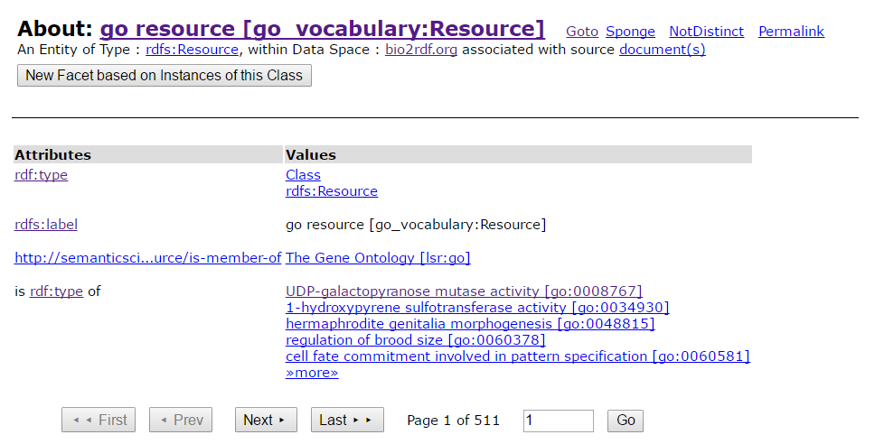
Go Function Properties in Bioportal
Go Function in BioPortal Dataset: http://bio2rdf.org/describe/?uri=http://bio2rdf.org/go_vocabulary:Resource
Notes:
This is a example, showing the properties of GO function in BioPortal dataset. You can check it in the attached link.

Slide 8
SPARQL queries over >1 endpoint
Retrieve GO function labels from BioPortal dataset for a chemical in Comparative Toxicogenomics Database. The chemical is named 2,6-xylidine and is identified by mesh: C007766
The SERVICE keyword is used to send part of the query against a remote SPARQL endpoint
This is a mechanism to communicate results from one endpoint to another, but this is not yet fully deployed.
CTD Dataset: http://download.bio2rdf.org/release/3/ctd/ctd.html

Slide 9
SPARQL queries over >1 endpoint use SERVICE keyword
#comments can be included
PREFIX prefixA: <http://example.org/prefixA#>
PREFIX prefixB: <http://example.org/prefixB:>
SELECT …
FROM <http://example.org/myDataset>
WHERE{
SERVICE <http://somewhere.org/sparql> {
…..
}
}
LIMIT 10

Slide 10
SPARQL queries over >1 endpoint
Retrieve GO function labels from BioPortal dataset for a chemical in Comparative Toxicogenomics Database. The chemical is named 2,6-xylidine and is identified by mesh: C007766
Query Pattern: Graph Pattern used to search the RDF data
WHERE {
<http://bio2rdf.org/mesh:C007766> ctd_vocab:has-function ?goFunction ;
rdfs:label ?chemical .
<http://bioportal.bio2rdf.org/sparql>{
… is used to send part of the query against a remote SPARQL endpoint SPARQL endpoint identifier
}
}
SERVICE
Notes:
Inside the query pattern, we create the connection with the remote SPARQL endpoint. In our specific case, we are running the query under ctd endpoint.
On the other side, we need to send part of the query into Bioportal endpoint, identified by the the URI above.

Slide 11
SPARQL queries over >1 endpoint
Retrieve GO function labels from BioPortal dataset for a chemical in Comparative Toxicogenomics Database. The chemical is named 2,6-xylidine and is identified by mesh: C007766
Full Query:
PREFIX ctd_vocab:<http://bio2rdf.org/ctd_vocabulary:>
PREFIX rdfs: <http://www.w3.org/2000/01/rdf-schema#>
SELECT distinct ?chemical ?goFunction ?label
WHERE {
<http://bio2rdf.org/mesh:C007766> ctd_vocab:has-function ?goFunction ;
rdfs:label ?chemical .
SERVICE <http://bioportal.bio2rdf.org/sparql>{
?goFunction rdfs:label ?label .
}
}
Notes:
This is the final query.

Slide 12
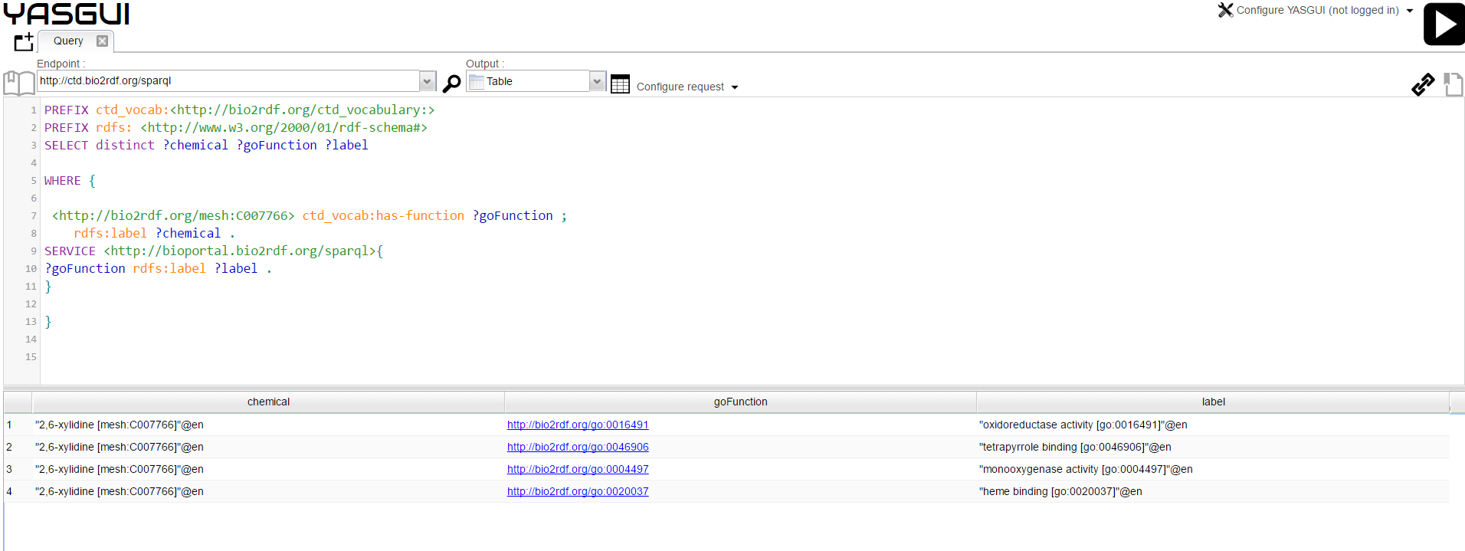
SPARQL queries over >1 endpoint
Retrieve GO function labels from BioPortal dataset for a chemical in Comparative Toxicogenomics Database. The chemical is named 2,6-xylidine and is identified by mesh: C007766
Notes:
Example of the query running under 2 endpoints (ctd and bioportal).

Slide 13
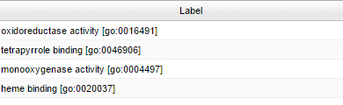
Special Type of Filtering
What if we want to display only “heme binding” function label?
FILTER regex
((str(?label), "heme binding")
Regex matches a language tag against a language range
str converts the label variable into a string

Slide 14
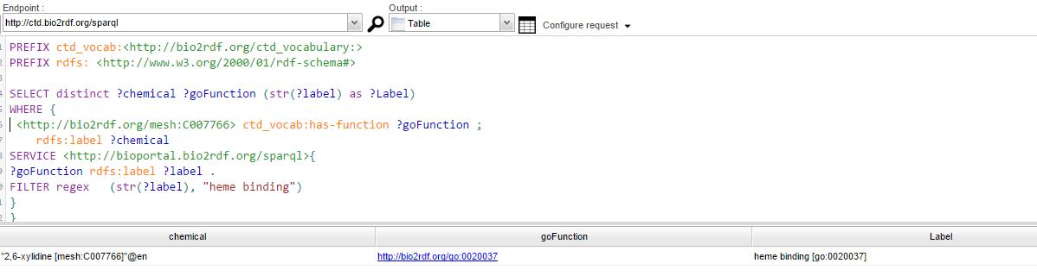
Special Type of Filtering
What if we want to display only “heme binding” function label?

Slide 15
Querying Alternatives
What if you want to query results from more than two graph patterns and want to output the combined results?
The UNION includes results from either of two graph patterns or more. Solutions to both sides of the UNION are included in the results.
UNION combines the result set of two separate graph patterns.

Slide 16
SPARQL anatomy for combining two graphs.
#comments can be included
PREFIX prefixA: <http://example.org/prefixA#>
PREFIX prefixB: <http://example.org/prefixB:>
SELECT …
FROM <http://example.org/myDataset>
WHERE{
{ … } #query graph 1
UNION
{ … } #query graph 2
}
LIMIT 10

